Slide 1
PI-Max3
Global handles and fast data collection examples using the PI-Max3

Slide 2
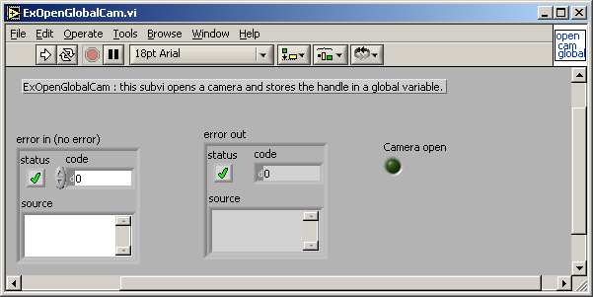
Open Toolkit and Camera
Open ExOpenGlobalCam.vi which can be found in your :
SIToolKit\LabView\Examples\xx_ver\Fast Examples\Open-Close Hardware folder. This only needs to be run once when you enter LabView. Note camera should be turned on and attached to the computer before this is run.

Slide 3
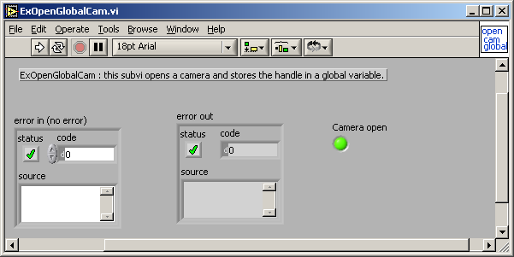
If the camera opens successfully you will get a green light in the LED on the front panel. There is now a global variable that holds the camera handle and camera open status for other programs to use.

Slide 4
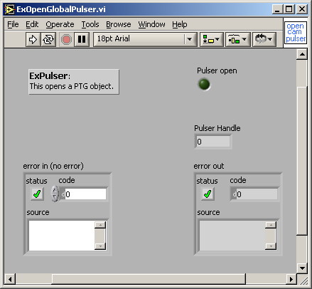
Open Pulser
Run the ExOpenGlobalPulser.vi
This opens the Pulser and stores the pulser handle into a global variable to be used by other VI’s

Slide 5
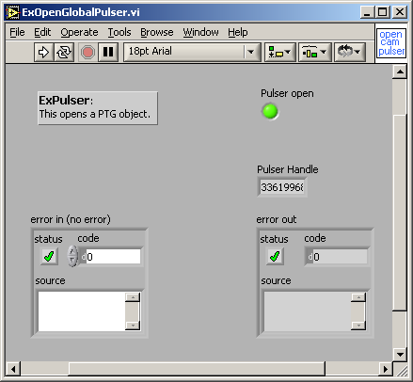
. If the pulser is opened successfully the LED will turn Green

Slide 6
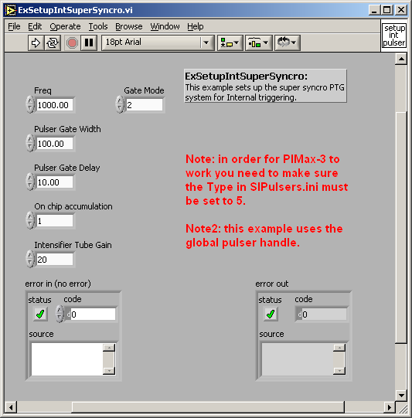
Setup PI-Max3 For Internal triggering.
This is good to try for a sanity check to make sure the system is working correctly as far as software and hardware are concerned since it is self contained and does not rely on outside triggering.

Slide 7
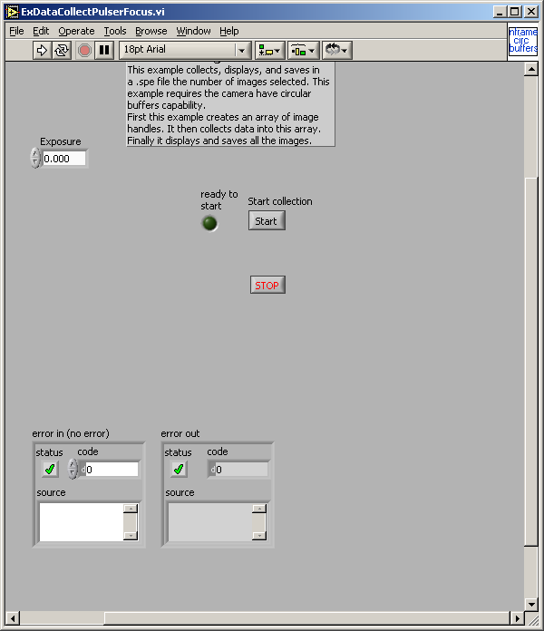
Run ExDataCollectPulserFocus.vi –
this will verify that the hardware is working. Wait until the ready to start led turns green then hit the start button.

Slide 8
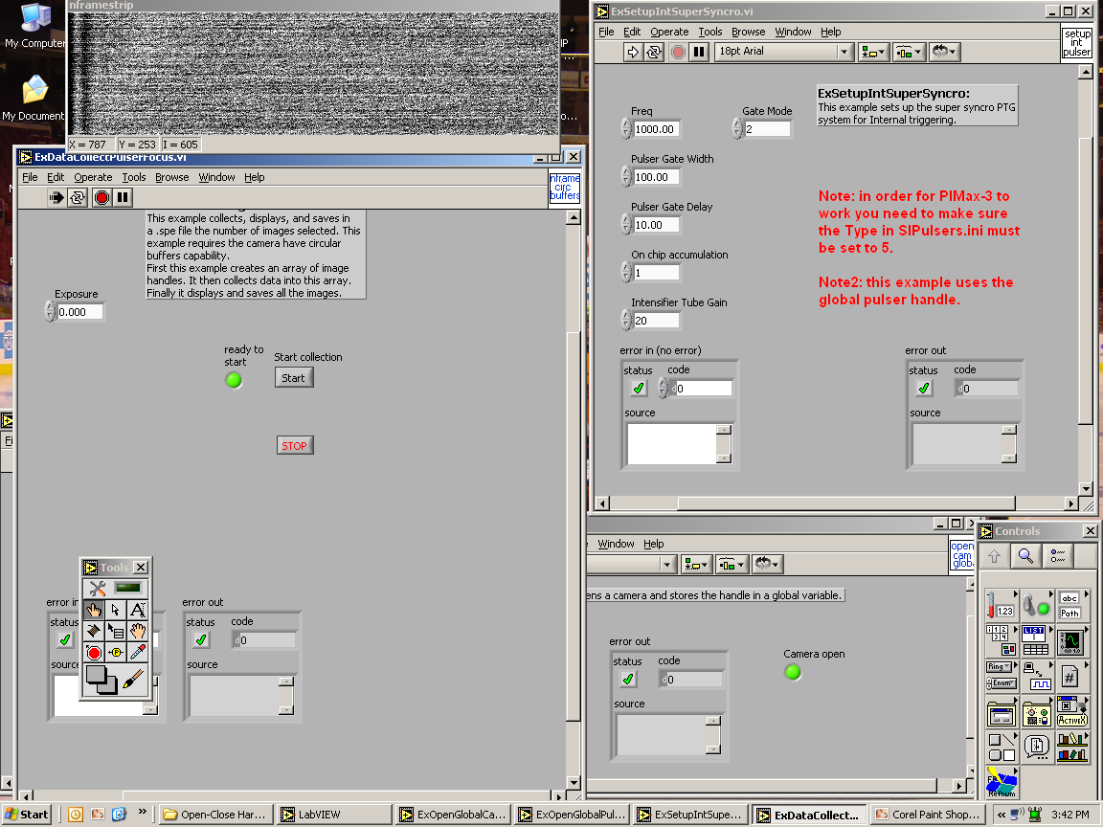
The focus program should display an image that is updated. Also on the back of the of the PI-Max3 the green gate indicator light should flash on and off.

Slide 9
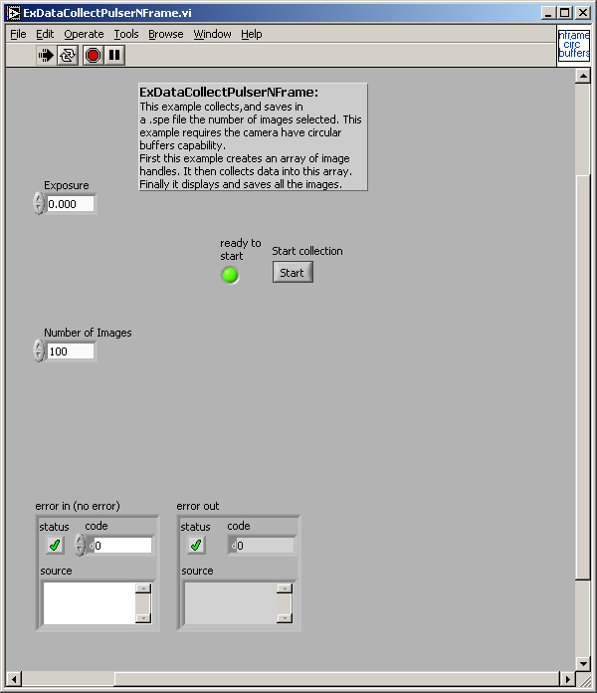
High speed data collection:
Run the ExDataCollectionPulserNFrame.vi This program is given a number of images to collect. It allocates in RAM enough buffer space (below Labview in C++) to hold this amount and then uses only a 4 byte handle in LabView for the actual data collection loop.
First wait for the ready to start LED is green then hit the start button. The data will be stored without display. When it is done a beep will sound and the program will then store the data into the file nframedata.

Slide 10
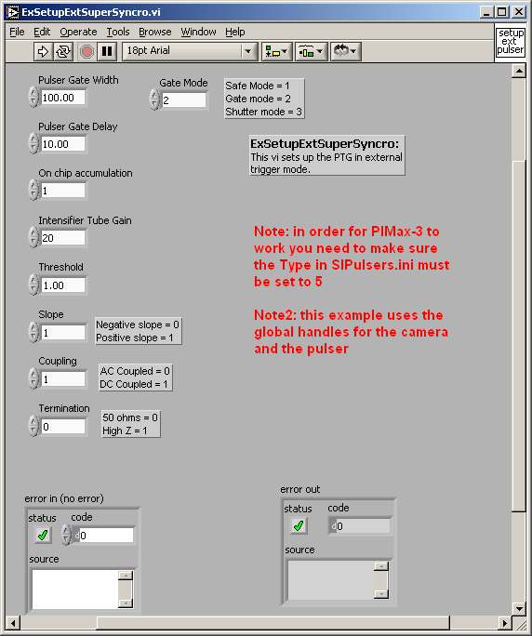
PI-Max3 in external triggering experiments.
Run ExSetupExtSuperSyncro.vi (in place of running ExSetupIntSuperSyncro.vi) to setup external triggering with the PI-Max3. After this both the ExDataCollectPulserFocus.vi and the ExDataCollectPulserNFrame.vi can be run to collect data.

Slide 11
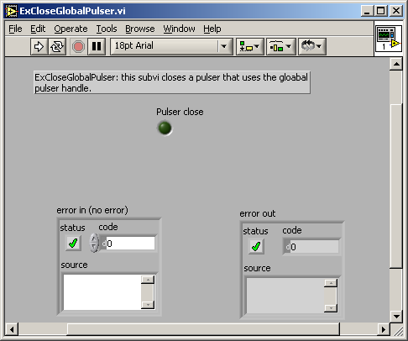
Before leaving LabView the software should be unloaded to deallocate buffers and close down the hardware. With a PI-Max system, first close down the Pulser section by running ExCloseGlobalPulser.vi

Slide 12

Then close out the camera, which will also close out the toolkit

